Slide 1
Chapter 1: Financial Statements and Business Decisions

Slide 2
4 Financial Statements
Balance Sheet = Reports the economic resources the firm owns and the sources of financing for those resources at a point in time.
Income Statement = Reports the firm’s ability to sell goods or services for more than their cost to produce and sell.
Statement of Stockholders’ Equity = Reports additional contributions or payments to investors and the amount of income the company reinvested for future growth.
Statement of Cash Flows = Reports the firm’s ability to generate cash and how it was used for a period of time.

Slide 3
Balance Sheet
ASSETS = LIABILITIES + STOCKHOLDERS’ EQUITY
Left side = Right side
Debits = Credits

Slide 4
Income Statement
REVENUES – EXPENSES = NET INCOME*
*Net Income is an after-tax amount

Slide 5
Statement of Stockholder’s Equity
Beginning Retained Earnings + Net Income* – Dividends = Ending Retained Earnings
*Net Income comes from the Income Statement

Slide 6
Statement of Cash Flows
Operating Activities = Cash flows that are directly related to earning income.
Investing Activities = Includes activities related to the acquisition or sale of the company’s plant and equipment and investments.
Financing Activities = Includes activities that are directly related to the financing of the enterprise itself. They involve the receipt or payment of money to investors and creditors.

Slide 7

Chapter 2
Investing and financing decisions and the Accounting System

Slide 8
Accounting Equation
A = L + SE
(Assets)
(Liabilities)
(Stockholders’ Equity)
Economic resources with probable future benefits owned or controlled by the entity. Measured by the historical cost principle.
Probable debts or obligations (claims to a company’s resources) that result from a company’s past transactions and will be paid with assets or services. Entities that a company owes money to are called creditors.
The financing provided by the owners and by business operations.
Notes:
Assets are economic resources with probable future benefits owned or controlled by an entity as a result of past transactions. In other words, they are the acquired resources the entity can use to operate in the future. To be reported, assets must have a measurable, verifiable value, usually based on the purchase price.
Liabilities are probable debts or obligations (claims to a company’s resources) that result from a company’s past transactions and will be paid with assets or services. Entities that a company owes money to are called creditors.
Stockholders’ equity (also called owners’ equity or shareholders’ equity) is the financing provided by the owners and by business operations. Owner-provided cash (and sometimes other assets) is referred to as contributed capital. Owners invest in the business and receive shares of stock as evidence of ownership.

Slide 9
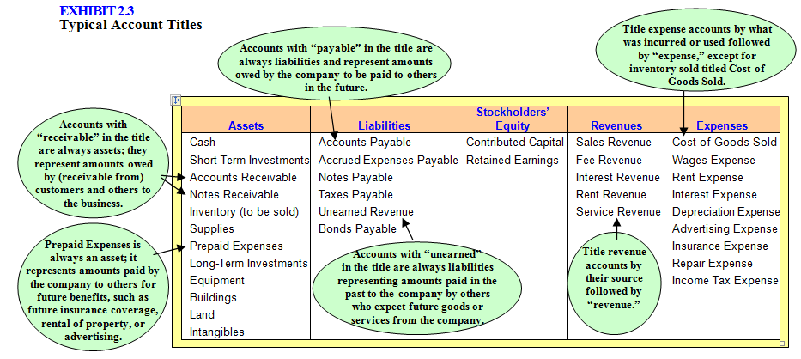
Account Classifications

Slide 10
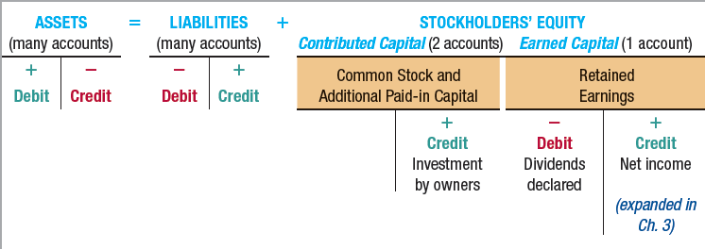
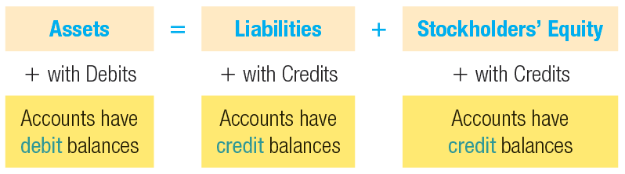
Adjusting Accounts

Slide 11
Main Takeaways
The accounting equation should always balance (Assets=Liabilities + SE)
In order to increase an asset account, you must debit it
In order to increase a liability/SE account, you must credit it
A trial balance is a listing of the account balances. It is used to make sure debits=credits
Current ratio= current assets/current liabilities

Slide 12
Chapter 3: Operating Decisions and the Accounting System

Slide 13
Chapter 3
Elements of the Income Statement
Revenues = Increase in assets or settlement of liabilities from ongoing operations
Expenses = Decreases in assets or increases in liabilities from ongoing operations
Gains = Increases in assets or settlement of liabilities from peripheral transactions
Losses = Decreases in assets or increases in liabilities from peripheral transactions
Peripheral vs Ongoing Transactions
Ex of Ongoing Transaction: If a company is in the business of selling books, the books they sell and receive money for in return would be recognized as revenue. Thus you would debit Cash or Accounts Receivables and Credit Sales Revenue when you sell the books.
Ex of Peripheral Transaction: If the company sold a piece of machinery used to sort books for more than the depreciated book value, they would make money on the sale of machinery, but since selling machinery is not what they are in business to do, they would recognize the money made as a gain, not a revenue. As a result you would still debit Cash; however, you would credit a gain.
Expanded Transactional Analysis

Slide 14
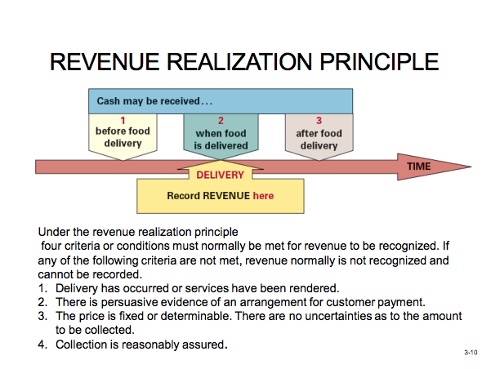
Accrual Accounting
Revenue Principle where the cash is received before the good or service is delivered (Company receives cash before good is delivered)
Debit Cash(+A), Credit Unearned Revenue(+L)
After the good is delivered…..
2) Debit Unearned Revenue(-L), Credit Sales Revenue (+SE)
Revenue Principle where the cash is received after the good or service is delivered (Company receives cash after good is delivered)
Debit Accounts Receivables (+A), Credit Sales Revenue (+SE)
Company is paid Cash……
Debit Cash (+A), Credit Accounts Receivables (-A)
Notes:
Note* In contrast to Accrual Based Accounting, in Cash Basis Accounting, Revenue is recorded when cash is received. Expenses are recorded when cash is paid.

Slide 15
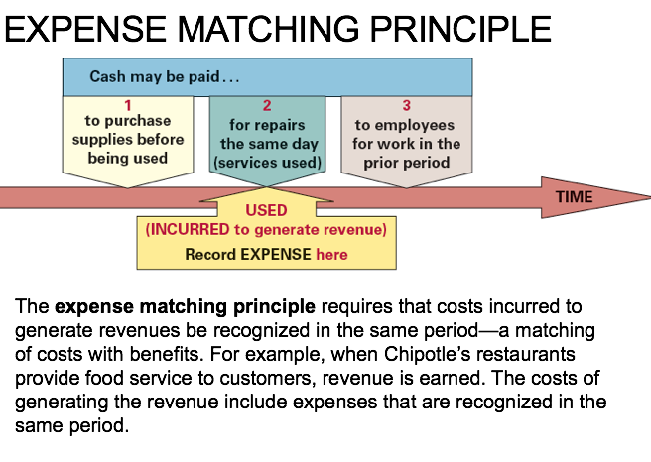
Expense Matching Principle where cash is paid before the good or service is delivered (Company pays cash before good is delivered)
Debit Prepaid Expense (+A), Credit Cash (-A)
Expense occurs….
Debit Expense (-SE), Credit Prepaid Expense(-A)
Expense Matching Principle where cash is after the good or service is delivered (Company pays cash after good is delivered)
Debit Expense (-SE), Credit Accounts Payable (+L)
Cash is paid….
Debit Accounts Payable (-L), Credit Cash (-A)

Slide 16
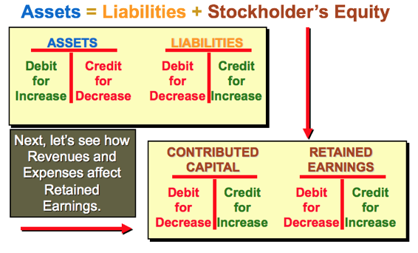
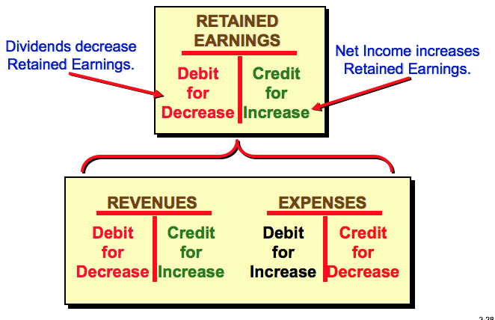
Expanded Transactional Analysis
Notes:
Expanded Transactional Analysis
Assets= Liabilities + Stockholder’s Equity
Assets: Debit for increase, Credit for decreases
Liabilities: Debit for decreases, Credit for Increase
Stockholder’s Equity can be broken into two different parts
Contributed Capital: Debit for decrease, Credit for increase
Retained Earnings: Debit for decrease, Credit for increase
For retained earnings, a payment of dividend or a negative net income would decrease your retained earnings. On the other hand, an increase in Net Income would increase your retained earnings.
When looking into Net Income, Revenues should always be Credited whereas Expenses should always be debited. Thus, revenues would increase your retained earnings whereas expenses would reduce your retained earnings.
Remember: Beginning Retained Earnings + Net Income – Dividends = Ending Retained Earnings (Flows into Stockholder’s Equity)

Slide 17
Common mistakes for Chapter 3
If someone issues shares of common stock for cash, multiply the number of shares of common stock by the par value per share in order to get the value that is credited to “common stock”. Any amount issued over par value is credited to “additional paid in capital”. You would Debit Cash for the amount of Common Stock and Additional Paid in Capital (if applicable) that was credited.
Short-term Notes Payable are due in 1 year or less. Long-term notes payable are due in more than one year.
If you sell something for $X and Cost of Goods sold is $Y, be sure to make two sets of journal entries. The first set of entries would be Debit Cash for $X and Credit Sales Revenue for $X. The second entry would Debit Cost of Goods Sold for $Y and Credit Inventory for $Y
If someone paid $3,600 for the current month's insurance and another $3,600 for next month's insurance payment, you would Debit Prepaid Insurance and Insurance Expense for $3,600 each. This is because the current month’s insurance would count as an Expense for this period based off the expense matching principle, whereas next month’s insurance payment would count as an Asset that will be “used” in the future. Then you would Credit Cash for $7,200. Next month, because you have already paid for the Insurance, you would debit Insurance Expense for $3,600 and Credit Prepaid Insurance for $3,600 to show that your Prepaid Insurance has been used.

Slide 18
Chapter 4: Adjustments, financial statements, and the quality of earnings

Slide 19

Chapter 4: Adjustments, Financial Statements, and Quality of Earnings
ADJUSTING ENTRIES are necessary at the end of the period to properly measure all revenues and expenses of that period
Net book value= Property and Equipment reported net of Accumulated Depreciation
Accumulated Depreciation = “contra” asset account. Contra accounts reduce account to which they are related
I.E. Property and Equipment are reduced by Accumulated Depreciation to arrive at Net Book Value
EPS = net income divided by average # of shares outstanding (# at the beginning of period + # at the end of period, divided by two)
Balance sheet accounts carried forward from one period to next. i.e. ending Cash balance of prior period is beginning Cash balance of next period
Income Statement accounts are temporary accounts because they cover a period of time and at the beginning of next period start over with a zero balance
At the end of each period, balances in temporary accounts transferred, or closed, to the Retained Earnings account by closing entry

Slide 20
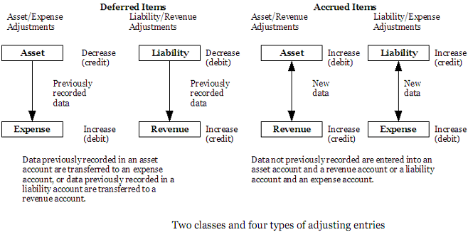
Chapter 4: Adjustments, Financial Statements, and Quality of Earnings
Four types of adjustments: Two types of adjustments increase revenues and other two increase expenses
Deferred Revenues = previous liabilities made when cash received in advance, & adjusted for revenue actually earned during period
Accrued Revenues = revenues earned but not yet recorded because cash received after the goods were delivered
Deferred Expenses = previously recorded assets, e.g. prepaid rent, that must be adjusted for expenses actually incurred during period
Accrued Expenses = expenses that were incurred but were not recorded because cash paid after goods received

Slide 21
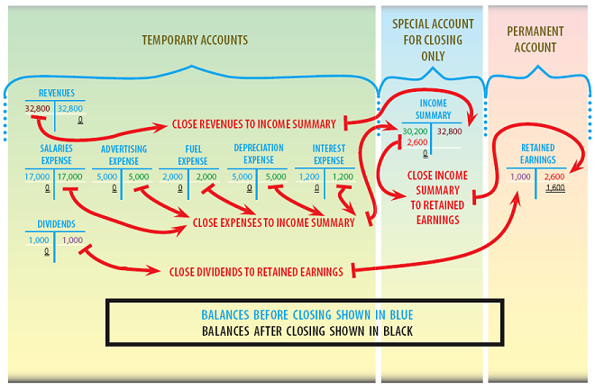
Chapter 4: Adjustments, Financial Statements, and Quality of Earnings
What Happens to Balance Sheet/Income Statement Numbers at Year End:

Slide 22
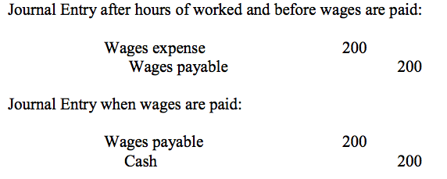
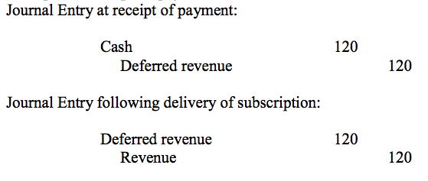
Chapter 4: Adjustments, Financial Statements, and Quality of Earnings
Cash |  |  | Retained Earnings |  |  | Dividends Paid
25,000* |  |  |  | 35
 | 4 (Div) |  |  |  |  | (Div) 4
 |  |  | (CE) 4 |  |  |  | 4 (CE)
 |  |  |  | 31
Illustration of Closing Entries, with Dividends Paid as a temporary account
Accruals example: wages incurred in the current period that will be paid in the future
Deferrals example: subscription payment received in advance
Remember:
Revenues – Expenses = Net Income, which increases (credit) Retained Earnings
Dividends decrease (debit) Retained Earnings
Retained Earnings is part of Stockholder’s Equity on the Balance Sheet

Slide 23
CHAPTER 5
Communicating and Interpreting Accounting Information

Slide 24
Players in the Accounting Communication Process
Regulators (SEC, FASB, PCAOB)
Management
Board of Directors
Auditors
Elected by stockholders to represent their interests
Includes Audit Committee – Maintains integrity of financial statements
CEO and CFO bear ultimate responsibility for financial statements
Accounting staff also responsible for accuracy of financial statements
Think Big 4 (PwC, EY, KPMG, Deloitte)
Assess the fairness and integrity of financial statements and related presentation

Slide 25
Users of Financial Accounting Information
Institutional Investors
Mutual funds, pension funds, endowments, sovereign wealth funds
Invest on behalf of others
Private Investors
Individuals who purchase shares in companies (think Fidelity and E-Trade)
College students, young/old adults, retirees
Lenders or Creditors
Suppliers, banks, commercial credit companies, and other financial institutions that lend money to companies

Slide 26
The Disclosure Process
Financial Statement Disclosure
SEC Regulation FD
Press Releases
Form 10-K: annual report that publically traded companies must file with SEC
FD stands for “Fair Disclosure”
Companies must provide all investors equal access to important company news
No Insider-Trading: managers and other insiders are not allowed to use non-public information about the company to gain an advantage
A written public news announcement normally distributed to major news services
Also usually released on company’s website in the “investor relations” section
Four basic financial statements
Related notes (footnotes)
Report of Independent Auditors (if applicable)
Additional Features and Characteristics
Comparative financial statements (usually 3 years back)
Additional subtotals and classifications (different companies use different formatting)
Additional disclosures (dozens of pages of detailed footnotes)

